Slide 1
How to Make Yourself Smarter via the Story of Artificial Intelligence
Patrick Henry Winston

Slide 2
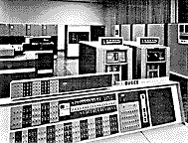

Slide 3
My Goal
To develop a computational theory of intelligence within my lifetime

Slide 4
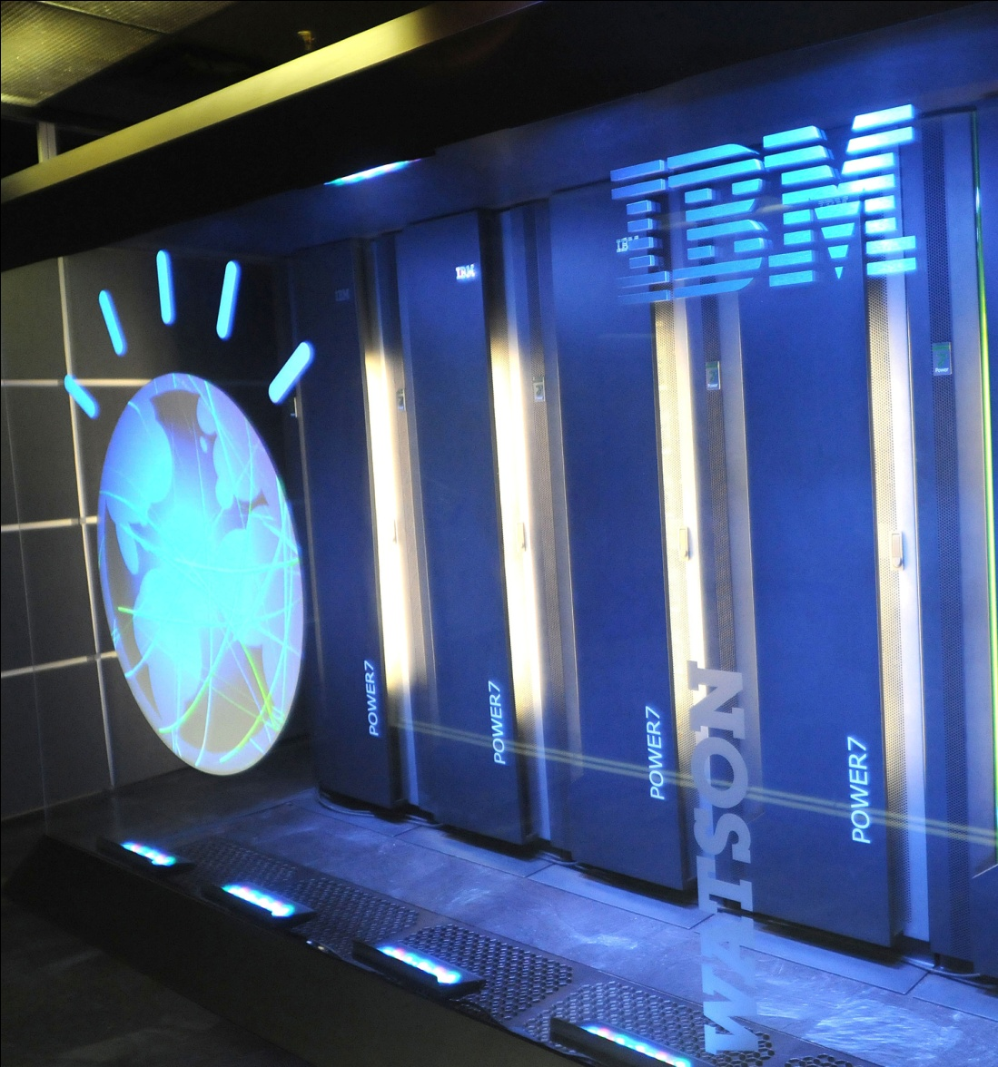

Slide 6
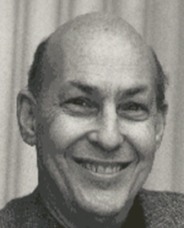
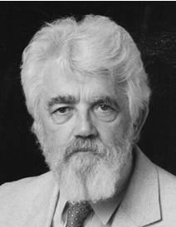
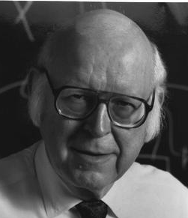
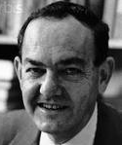

Slide 7

Analogical reasoning
Anytime algorithms
Bayesian techniques
Case-based reasoning
Computational linguistics
Connectionism
Constraint satisfaction
Cross-modal clustering
Cyc
Explanation based learning
Frames
Fuzzy sets
Genetic algorithms
Image understanding
Information retrieval
Intermediate features
K-lines
Knowledge engineering
Layered reasoning
Legged locomotion
Lisp, Smalltalk, and Logo
Logic systems
Machine learning
Means-ends
Memory based control
Model based systems
Multiple methods
Multiple resolution
Neural nets
Open mind
Planning and scheduling
Probabilistic reasoning
Problem reduction
Propagator architecture
Question answering
Reasoning hierarchies
Regularity based learning
Reinforcement learning
Representation
Rule based systems
Search
Self-organizing maps
Soar
Speech understanding
Streams and counter streams
Structure mapping
Subsumption
Symbolic mathematics
Visual and motor routines
Wait-and-see algorithms

Slide 8
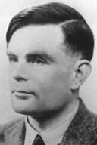
Notes:
Computing machinery and intelligence – debunked 9 arguments

Slide 9
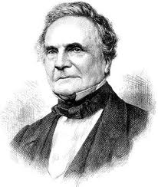
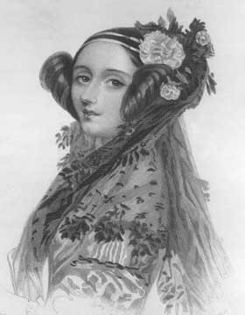

Slide 10
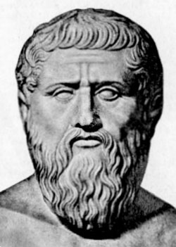

Slide 11
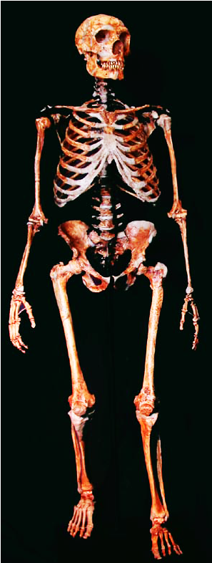
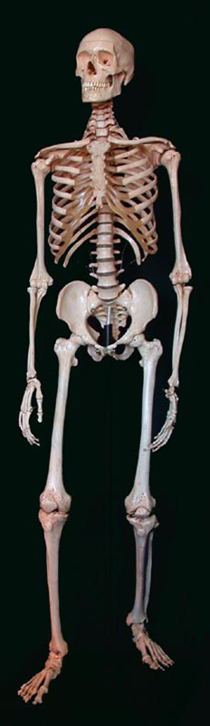

Slide 12
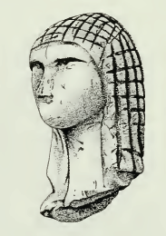
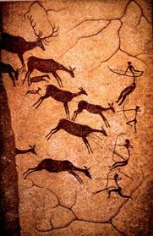
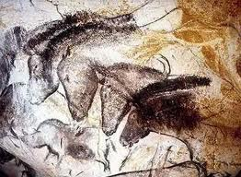
Notes:
Brassempouy, Lascaux

Slide 13
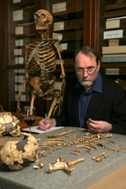

Slide 14
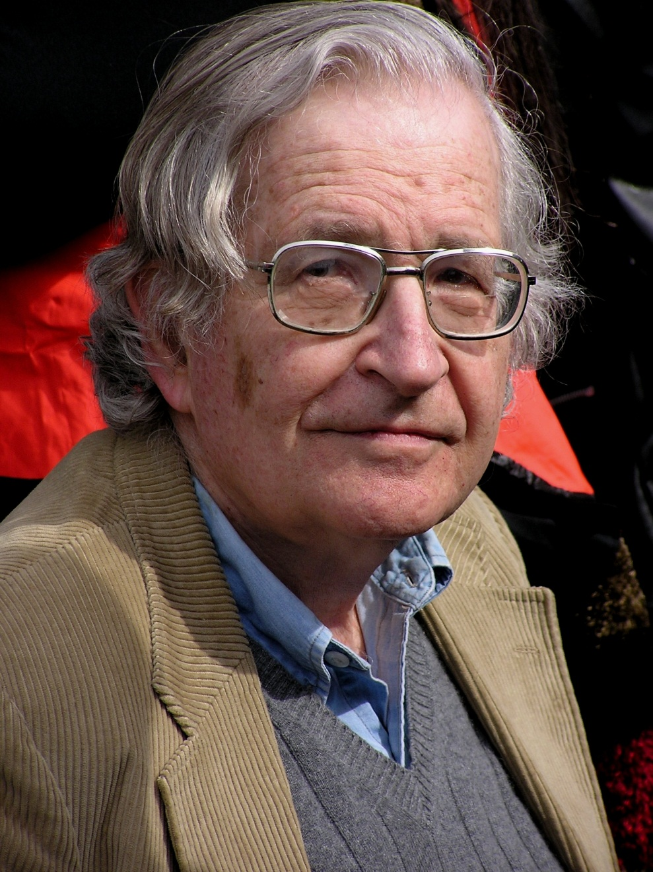

The Inner Language Hypothesis
∞

Slide 15



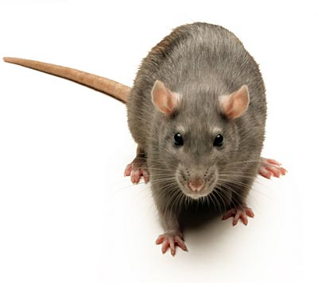
Food

Slide 16
Food

Slide 17
The Strong Story Hypothesis
The mechanisms that enable us humans to tell, understand, and recombine stories separate our intelligence from that of other primates.

Slide 18
Fairy and folk tales
Religious parables
Ethnic narratives
History
Literature
Experience
News
…
  Law
  Business
  Medicine
  Defense
  Diplomacy
  Engineering
  Science
  …

Slide 19
The Steps
Characterize behavior
Formulate computational problems
Propose computational solutions
Implement exploratory systems
Crystallize out the principles

Slide 20
Macbeth and Macduff are thanes. Lady Macbeth is Macbeth's greedy wife. Duncan, who is Macduff's friend, is the king, and Macbeth is Duncan's successor... Witches had visions and talked with Macbeth ... Lady Macbeth persuaded Macbeth to want to become the king. Macbeth murders Duncan… Then, Macduff kills Macbeth... The witches's predictions came true.

Slide 21
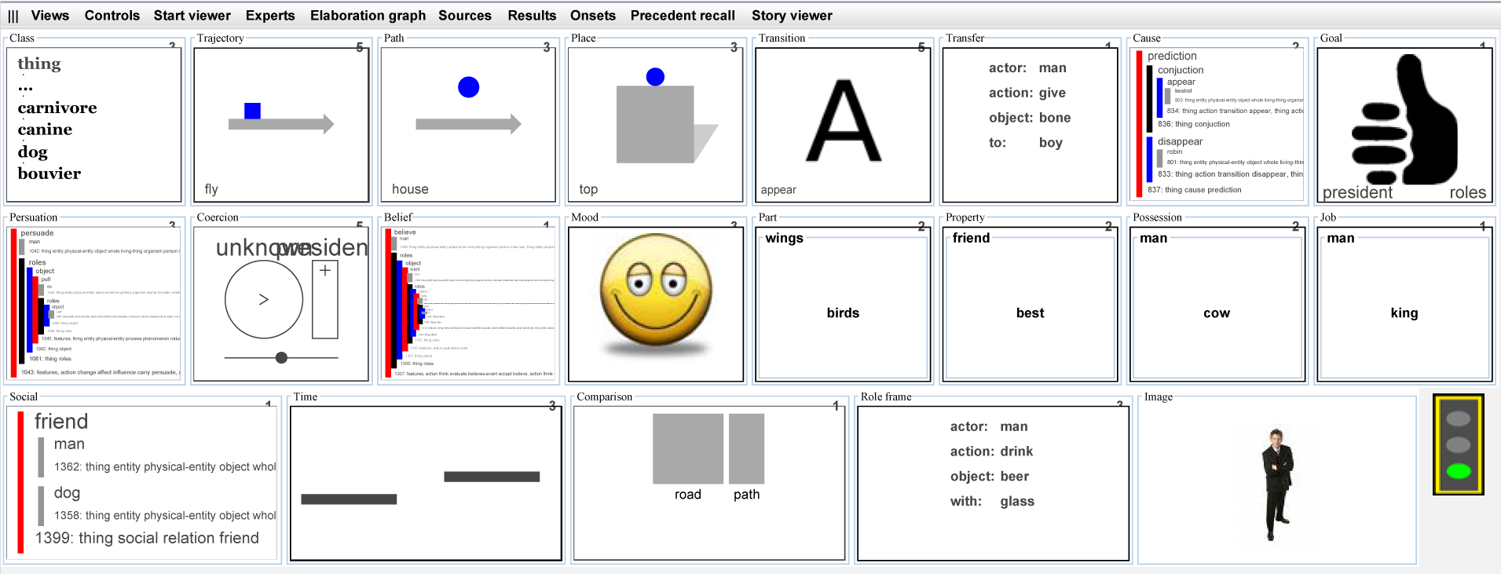

Slide 22
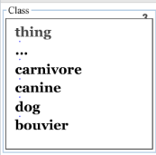

Slide 23
Path
Object
Source (from)
Destination (to)
Place
Above
Near
Top
Back
Left
Side
Front
Right
In back of
In front of
Bottom
Under

Slide 25
Emotion rule:
X may want to kill Y because X is angry at Y.
Revenge concept pattern:
X is my friend.
X's harming Y leads to Y's harming X.

Slide 26
Demonstration
Sentences
Macbeth with sources
Macbeth with culture
Question answering
Estonia with point of view
Taliban for fun
Hamlet with anticipation
Gap filling
Listener modeled story telling

Slide 27
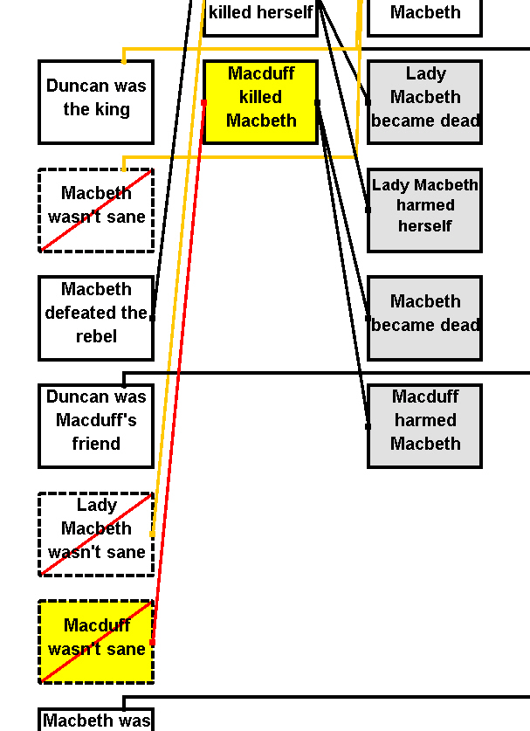
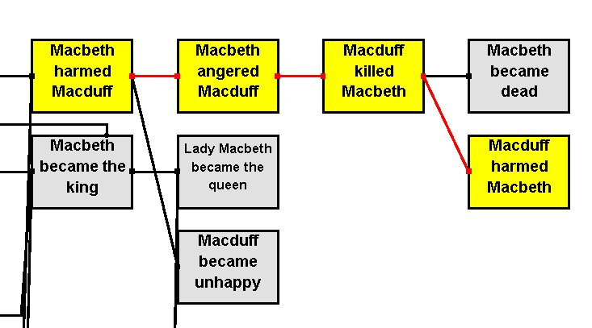

Slide 28
On a commonsense level
Dr. Jeckl thinks Macduff kills Macbeth because Macduff isn't sane. Mr. Hyde thinks Macduff kills Macbeth because Macbeth angers Macduff.
On a conceptual level
Dr. Jeckl thinks Macduff kills Macbeth is part of act of Insane violence. Mr. Hyde thinks Macduff kills Macbeth in Pyrrhic victory and Revenge patterns.

Slide 29
The USA knew the Viet Cong were preparing to attack the USA.
The USA knew the USA would defeat the Viet Cong.
The USA knew the Viet Cong knew the USA would defeat the Viet Cong.
The USA believed the Viet Cong would not attack the USA.
The Viet Cong attacked the USA.
The Israelis knew the Egyptians were preparing to attack the Israelis.
The Israelis knew the Israelis would defeat the Egyptians.
The Israelis knew the Egyptians knew the Israelis would defeat the Egyptians.
The Israelis believed the Egyptians would not attack the Israelis.
?

Slide 30
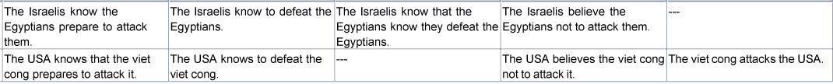
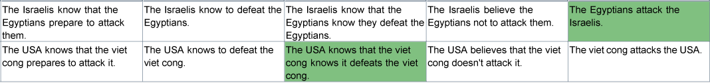

Slide 31
The USA knows that the viet cong knows it defeats the viet cong.
The Egyptians attack the Israelis

Slide 32
Duncan is a person. Lady Macbeth is a person. Macduff is a person. Macbeth is a person. A thane is a noble. Macbeth is a thane. Macduff is a thane. Lady Macbeth is greedy. Macbeth defeats a rebel. Appear is a success. Macbeth has a success. Witches talk with Macbeth. Witches have visions. Duncan rewards Macbeth because Duncan becomes happy. Macbeth wants to become king because Lady Macbeth persuades Macbeth to want to become king. Macbeth murders Duncan.
Duncan becomes dead.

Slide 33
Duncan is a person. Lady Macbeth is a person. Macduff is a person. Macbeth is a person. A thane is a noble. Macbeth is a thane. Macduff is a thane. Lady Macbeth is greedy. Macbeth defeats a rebel. Appear is a success. Macbeth has a success. Witches talk with Macbeth. Witches have visions. Duncan rewards Macbeth because Duncan becomes happy. Macbeth wants to become king because Lady Macbeth persuades Macbeth to want to become king.
Duncan becomes dead because Macbeth murders Duncan.

Slide 34
Duncan is a person. Lady Macbeth is a person. Macduff is a person. Macbeth is a person. A thane is a noble. Macbeth is a thane. Macduff is a thane. Lady Macbeth is greedy. Macbeth defeats a rebel. Appear is a success. Macbeth has a success. Witches talk with Macbeth. Witches have visions. Duncan rewards Macbeth because Duncan becomes happy. Macbeth wants to become king because Lady Macbeth persuades Macbeth to want to become king. Macbeth murders Duncan.
Duncan becomes dead because if a person murders another person, the other person becomes dead.

Slide 35
Inform
Anticipate
Spoon feed
Teach commonsense
Teach reflection
Persuade and propagandize
Negotiate and reconcile

Slide 36
The Social-Animal Hypothesis
Our social nature amplifies the value of story telling and perceptual reuse.

Slide 37
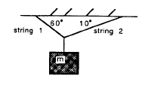
Self explanation
35
10
Worst
Best

Slide 38
The Directed Perception Hypothesis
The mechanisms that enable us humans to direct and hallucinate with our perceptual faculties separate our intelligence from that of other primates.

Slide 39
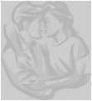
Notes:
39
From brain science:
Biologists have known for a long time that for every nerve bundle going from perception up, there is another going down. And now, MRI research of various sorts shows that the “periphery” lights up just about all the time. Here, amazingly, the cerebellum lights up when you think about verbs that go with nouns, as when you think hammer when someone says nail. Such capabilities would have been regarded as absurd science fiction when Turing and Minsky shaped the field. Then, of course, the biologists have known for a long time that for every nerve bundle going from perception up, there is another going down. And now,

Slide 40
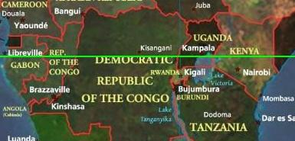

Slide 41
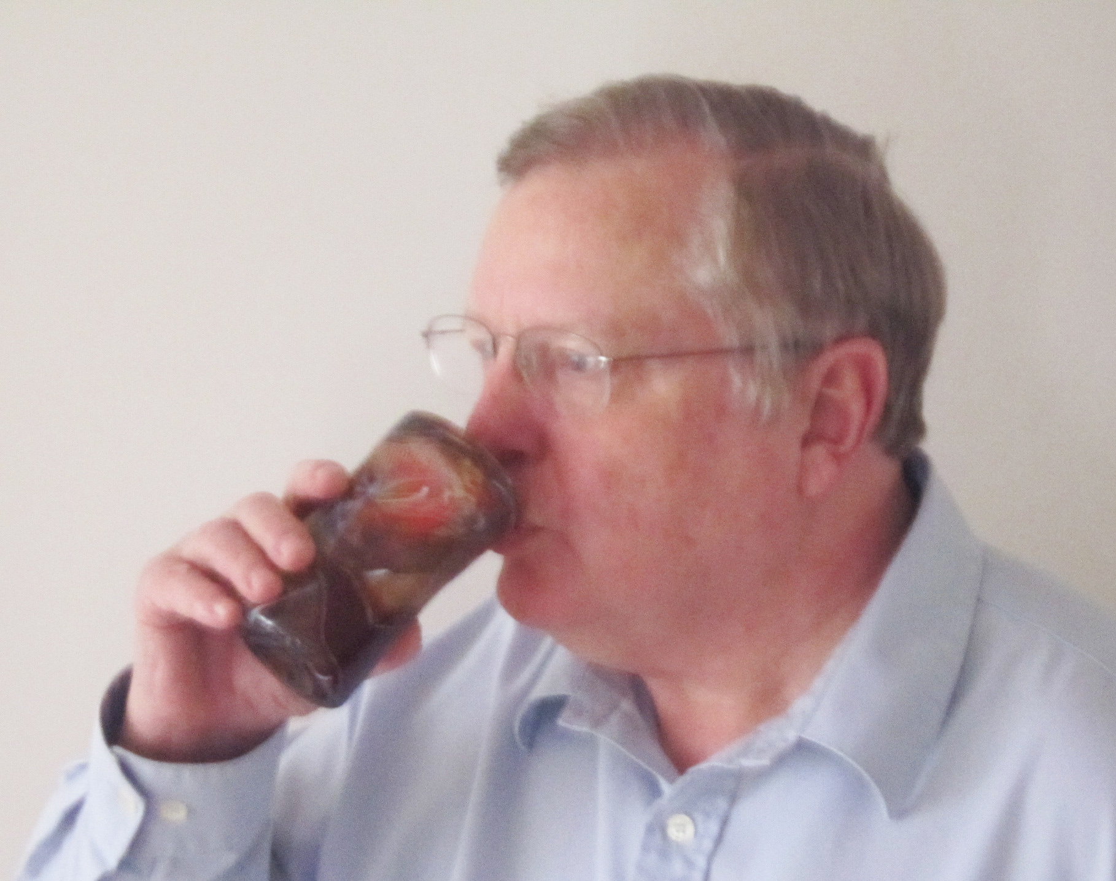

Slide 42
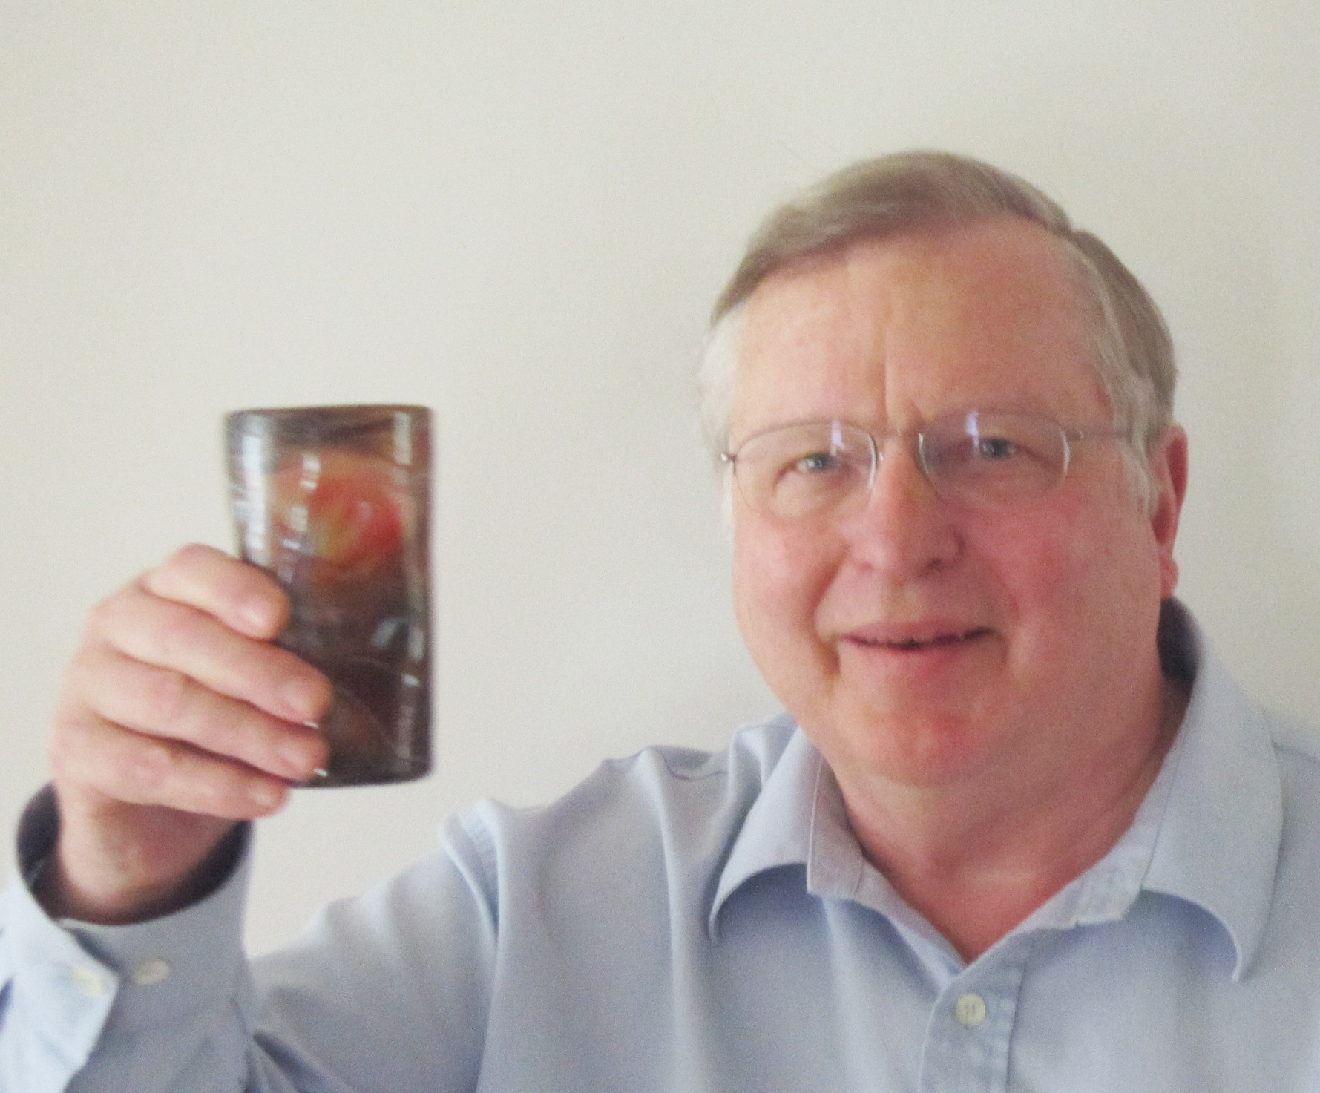

Slide 43


Slide 44
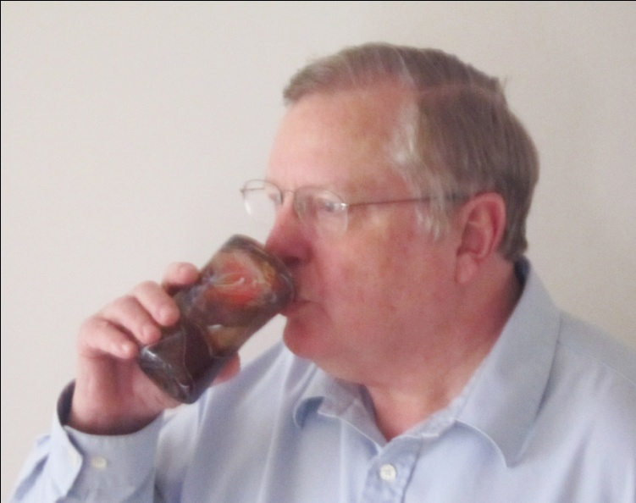


Slide 45
The Exotic Engineering Hypothesis
Parser
Semantic analyzer
Commonsense rules
Concept patterns
Perceptual imaginer
Biases from culture, morals, religion, experience, friends, family, education
Reference stories and story themes
Story
imaginer
Model of teller
Models of participants
Model of listener
Generator
Model of I
Commonsense rules
Semantic analyzer
Concept patterns
Parser
Perception
based disambiguation

Slide 46
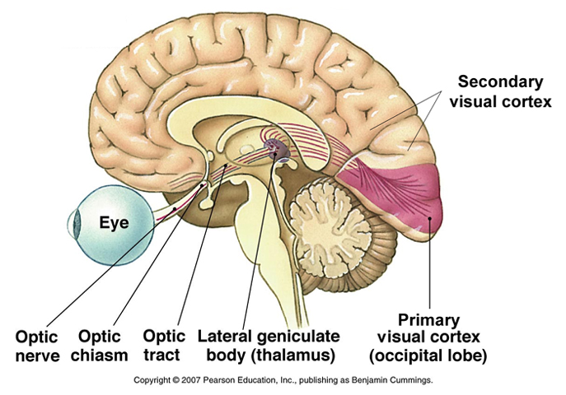

Slide 47
The Vision
The inner language hypothesis
The strong story hypothesis
The social animal hypothesis
The directed perception hypothesis
The exotic engineering hypothesis

Slide 48
If you want to be smarter…
Tell yourself stories
Draw pictures
Talk to somebody
Take notes

Slide 49
Contributions to come
Understanding ourselves
Understanding each other

